Slide 1

Chapter 8
Equilibrium and Elasticity

Slide 2


Reading Quiz
An object is in equilibrium if
F_{net} = 0.
τ_{net} = 0.
either A or B.
both A and B.
→
→
→
→
Slide 8-5
Notes:
Answer: D

Slide 3
Answer
An object is in equilibrium if
F_{net} = 0.
τ_{net} = 0.
either A or B.
both A and B.
→
→
→
→
Slide 8-6
Notes:
Answer: D

Slide 4
Reading Quiz
An object will be stable if
its center of gravity is below its highest point.
its center of gravity lies over its base of support.
its center of gravity lies outside its base of support.
the height of its center of gravity is less than 1/2 its total height.
Slide 8-7
Notes:
Answer: B

Slide 5
Answer
An object will be stable if
its center of gravity is below its highest point.
its center of gravity lies over its base of support.
its center of gravity lies outside its base of support.
the height of its center of gravity is less than 1/2 its total height.
Slide 8-8
Notes:
Answer: B

Slide 6
Reading Quiz
Hooke’s law describes the force of
gravity.
a spring.
collisions.
tension.
none of the above.
Slide 8-9
Notes:
Answer: B

Slide 7
Answer
Hooke’s law describes the force of
gravity.
a spring.
collisions.
tension.
none of the above.
Slide 8-10
Notes:
Answer: B

Slide 8
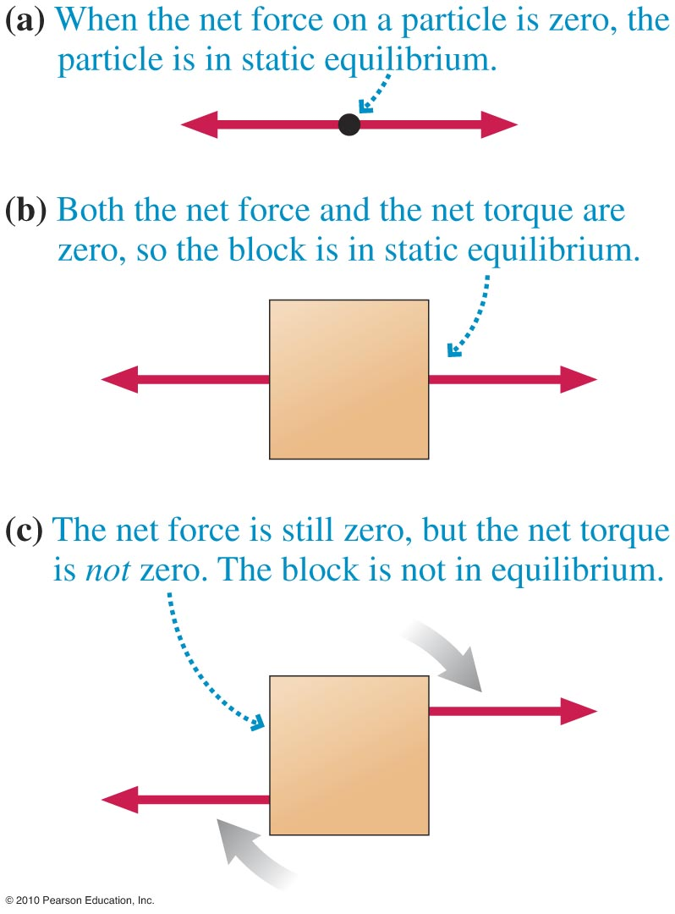
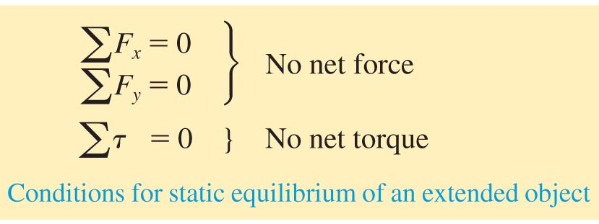
Torque and Static Equilibrium
For an extended object to be in equilibrium, the net force and the net torque must be zero.
Slide 8-11

Slide 9
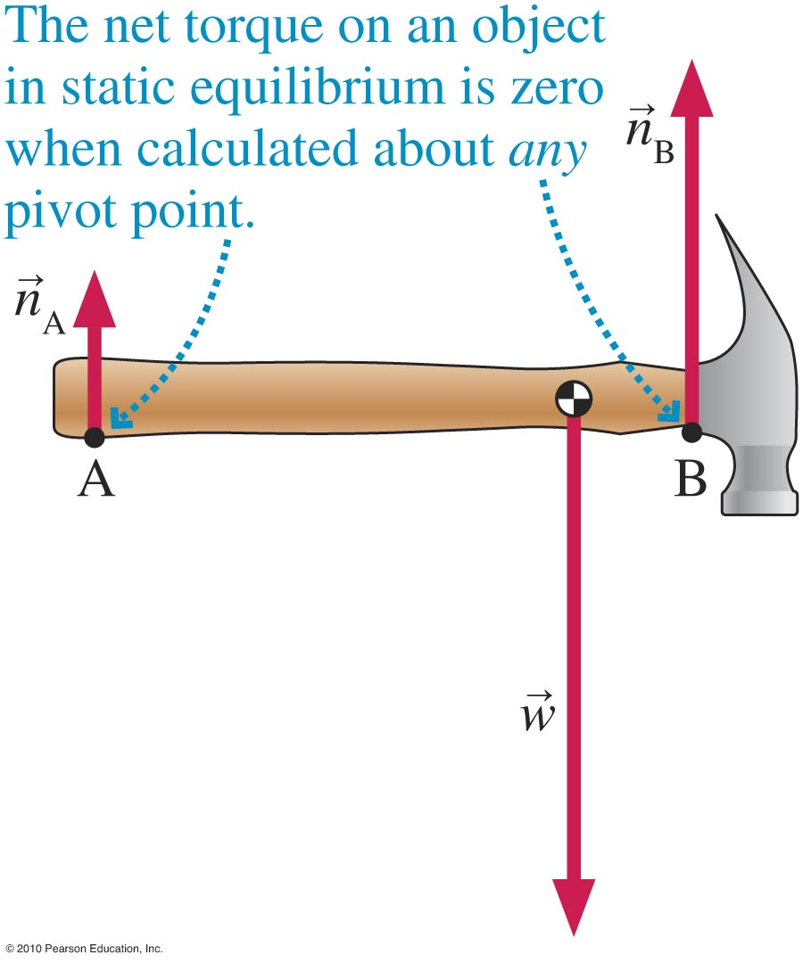
Choosing the Pivot Point
Slide 8-12

Slide 10
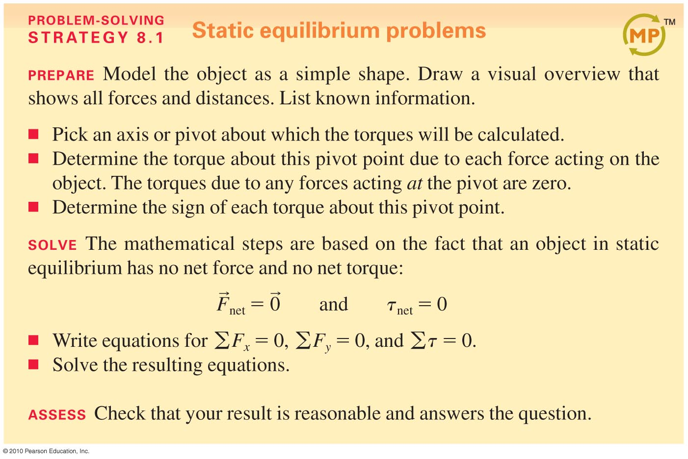
Solving Static Equilibrium Problems
Slide 8-13

Slide 11
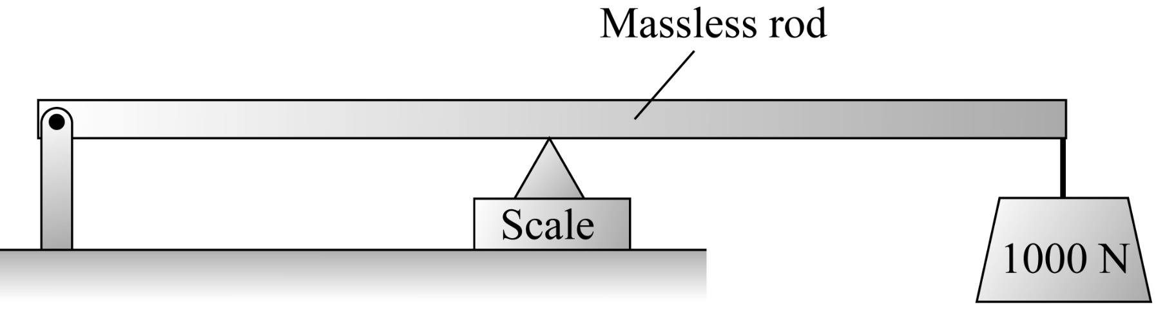
Checking Understanding
What does the scale read?
500 N
1000 N
2000 N
4000 N
Slide 8-14
Notes:
Answer: C

Slide 12
Answer
What does the scale read?
500 N
1000 N
2000 N
4000 N
Slide 8-15
Notes:
Answer: C

Slide 13




Example Problem
A 2-m-long board weighing 50 N extends out over the edge of a table, with 40% of the board’s length off the table. How far beyond the table edge can a 25 N cat walk before the board begins to tilt?
$$2\text{m}$$
$$F_{l}$$
$$F_{r}$$
Slide 8-16

Slide 14






A 2-m-long board weighing 50 N extends out over the edge of a table, with 40% of the board’s length off the table. How far beyond the table edge can a 25 N cat walk before the board begins to tilt?
$$.6\text{m}$$
$$.4\text{m}$$
$$F_{c}$$
$$F_{l}$$
$$F_{r}$$
$$F_{c}$$
Slide 8-16

Slide 15




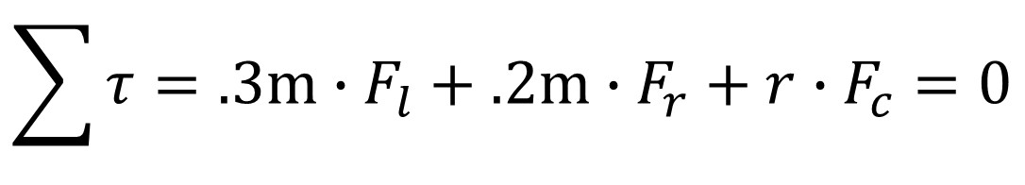
A 2-m-long board weighing 50 N extends out over the edge of a table, with 40% of the board’s length off the table. How far beyond the table edge can a 25 N cat walk before the board begins to tilt?
$$.3\text{m}$$
$$.2\text{m}$$
$$F_{l}$$
$$F_{c}$$
$$F_{r}$$
$$\sum{τ}=.3\text{m}∙F_{l}+.2\text{m}∙F_{r}+r∙F_{c}=0$$
Slide 8-16

Slide 16


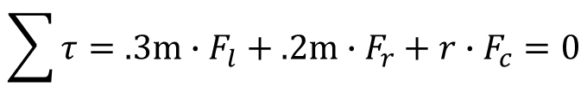
A 2-m-long board weighing 50 N extends out over the edge of a table, with 40% of the board’s length off the table. How far beyond the table edge can a 25 N cat walk before the board begins to tilt?
$$.3\text{m}$$
$$.2\text{m}$$
$$F_{l}$$
$$F_{c}$$
$$F_{r}$$
$$F_{l}=.6∙50\text{N}$$
$$F_{r}=.4∙50\text{N}$$
$$\sum{τ}=.3\text{m}∙F_{l}+.2\text{m}∙F_{r}+r∙F_{c}=0$$
Slide 8-16

Slide 17
A 2-m-long board weighing 50 N extends out over the edge of a table, with 40% of the board’s length off the table. How far beyond the table edge can a 25 N cat walk before the board begins to tilt?
$$.3\text{m}$$
$$.2\text{m}$$
$$F_{l}$$
$$F_{c}$$
$$F_{r}$$
$$.3\text{m}∙.6∙50\text{N}+.2\text{m}∙.4∙50\text{N}+r∙25\text{N}=0$$
Slide 8-16

Slide 18
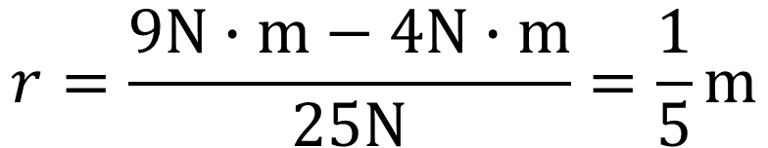

A 2-m-long board weighing 50 N extends out over the edge of a table, with 40% of the board’s length off the table. How far beyond the table edge can a 25 N cat walk before the board begins to tilt?
$$.3\text{m}$$
$$.2\text{m}$$
$$F_{l}$$
$$F_{c}$$
$$F_{r}$$
$$\text{9}\text{N}−4\text{N}−r∙25\text{N}=0$$
$$r=\frac{9\text{N}∙\text{m}−4\text{N}∙\text{m}}{25\text{N}}=\frac{1}{5}\text{m}$$
Slide 8-16

Slide 19
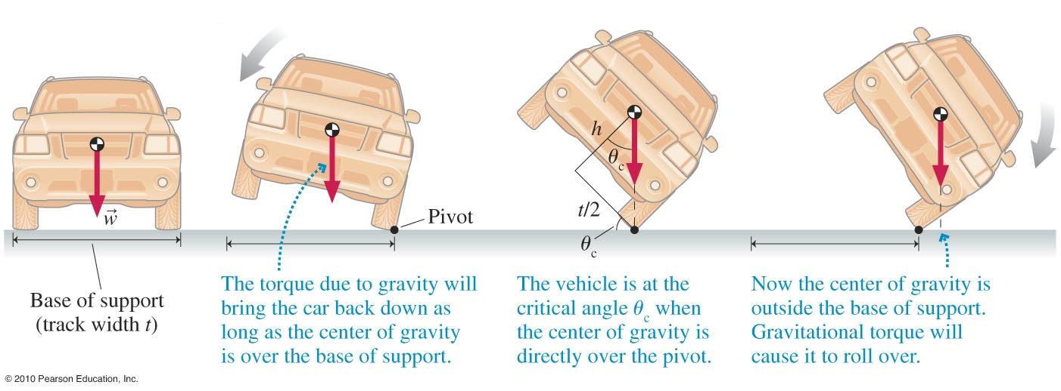
Stability of a Car
Slide 8-19

Slide 20
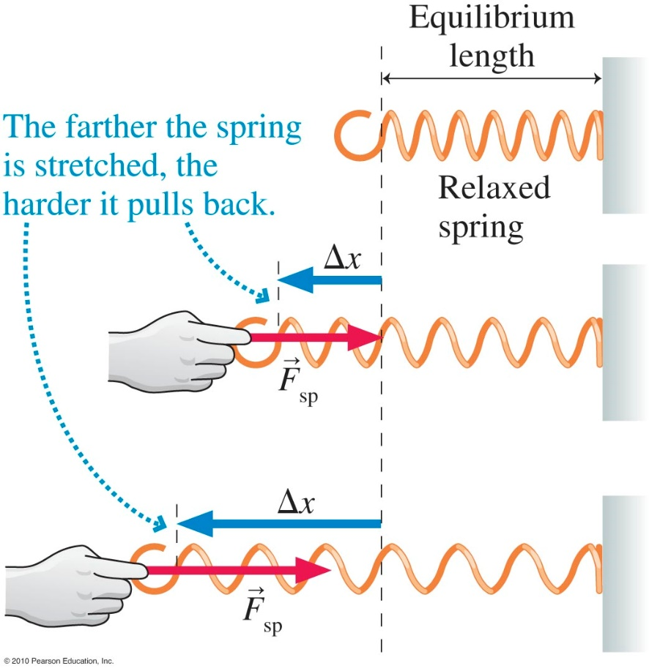
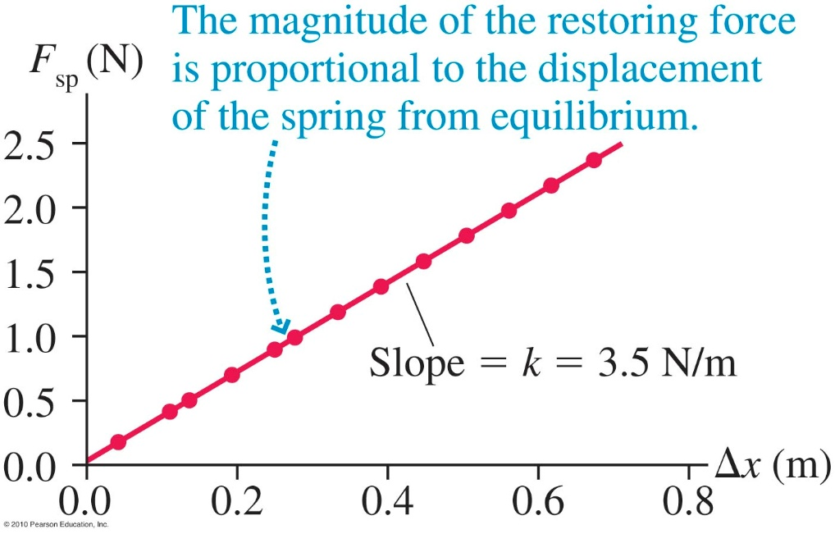
The Spring Force
The magnitude of the spring force is proportional to the displacement of its end:
F_{sp} = k ∆x
Slide 8-21

Slide 21
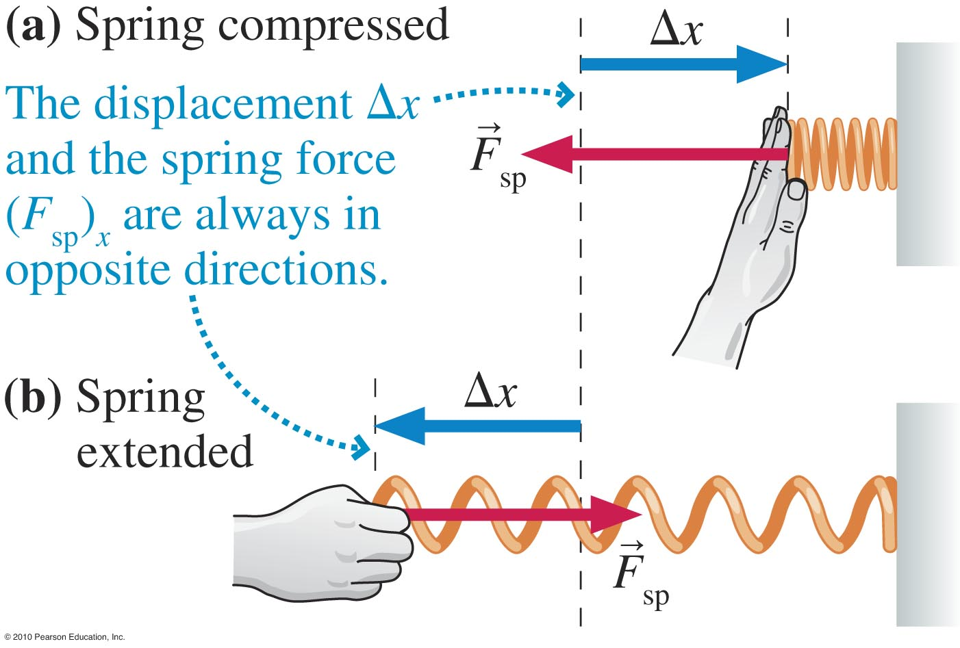
Hooke’s Law
The spring force is directed oppositely to the displacement. We can then write Hooke’s law as
(F_{sp})_{x} = –k ∆x
Slide 8-22

Slide 22
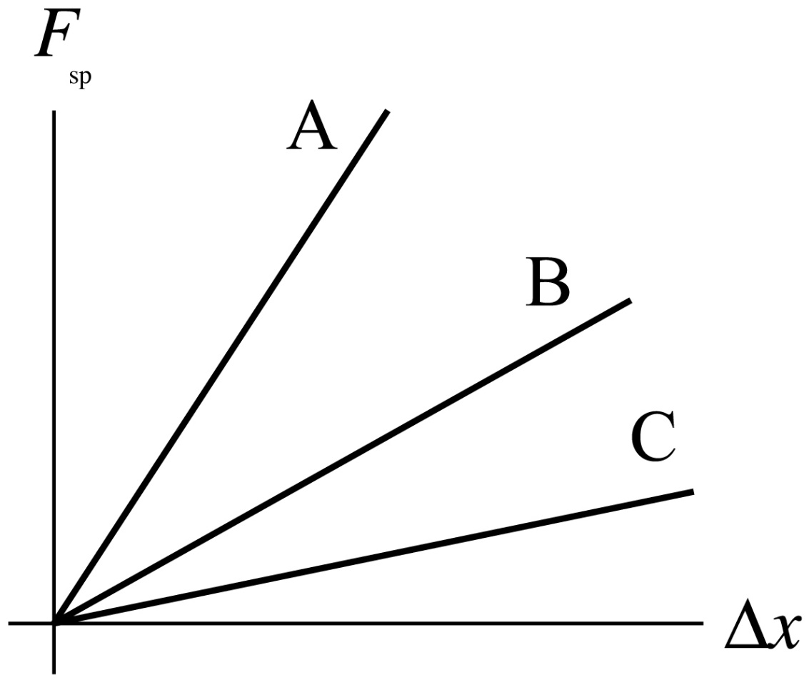
Checking Understanding
Which spring has the largest spring constant?
Slide 8-23
Notes:
Answer: A

Slide 23
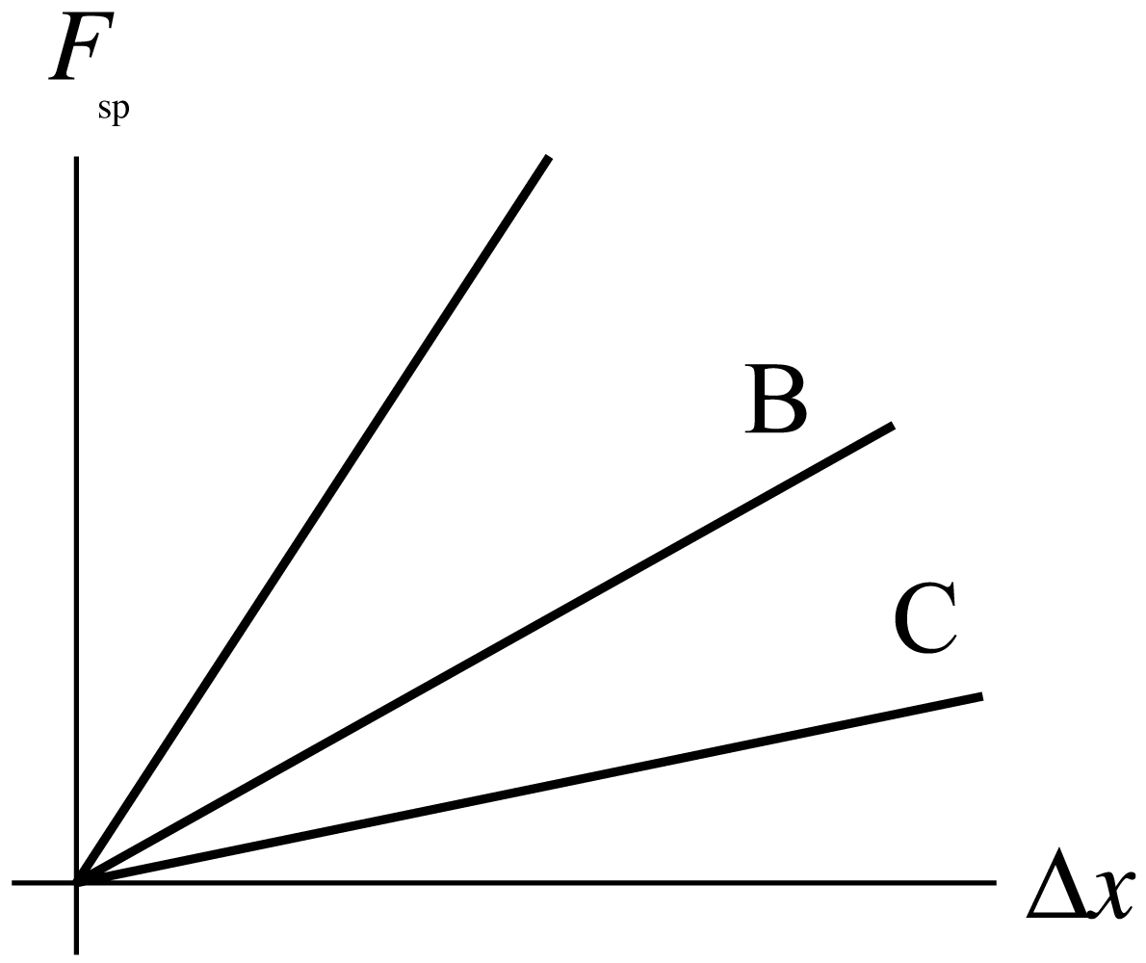
Answer
Which spring has the largest spring constant?
A
Slide 8-24
Notes:
Answer: A

Slide 24
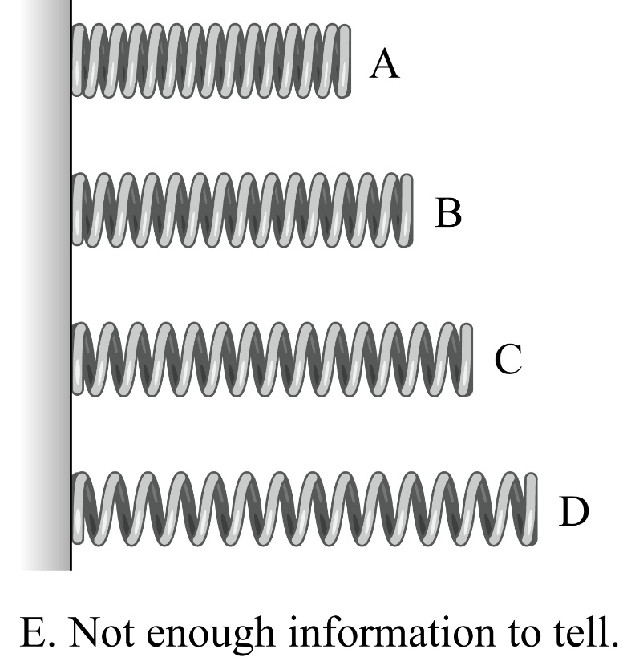
Checking Understanding
The same spring is stretched or compressed as shown below. In which case does the force exerted by the spring have the largest magnitude?
Slide 8-25
Notes:
Answer: E. The idea is that the force is determined by the displacement from the spring’s equilibrium length, which is not given.

Slide 25
Answer
The same spring is stretched or compressed as shown below. In which case does the force exerted by the spring have the largest magnitude?
E. Not enough information to tell.
Slide 8-26
Notes:
Answer: E. The idea is that the force is determined by the displacement from the spring’s equilibrium length, which is not given.

Slide 26
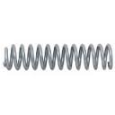
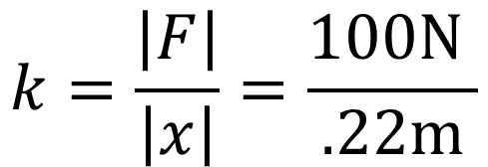


Example Problem
A 20-cm-long spring is attached to a wall. When pulled horizontally with a force of 100 N, the spring stretches to a length of 22 cm. What is the value of the spring constant?
$$\left|F\right|=k\left|x\right|$$
$$k=\frac{\left|F\right|}{\left|x\right|}=\frac{100\text{N} }{.22\text{m}}$$
$$100\text{N}$$
Slide 8-27

Slide 27


Example Problem
The same spring is now used in a tug-of-war. Two people pull on the ends, each with a force of 100 N. How long is the spring while it is being pulled?
$$100\text{N}$$
$$100\text{N}$$
22 cm
Slide 8-28

Slide 28


Example Problem
The same spring is now suspended from a hook and a 10.2 kg block is attached to the bottom end. How long is the stretched spring?
$$10.2\text{kg}$$
Slide 8-29

Slide 29
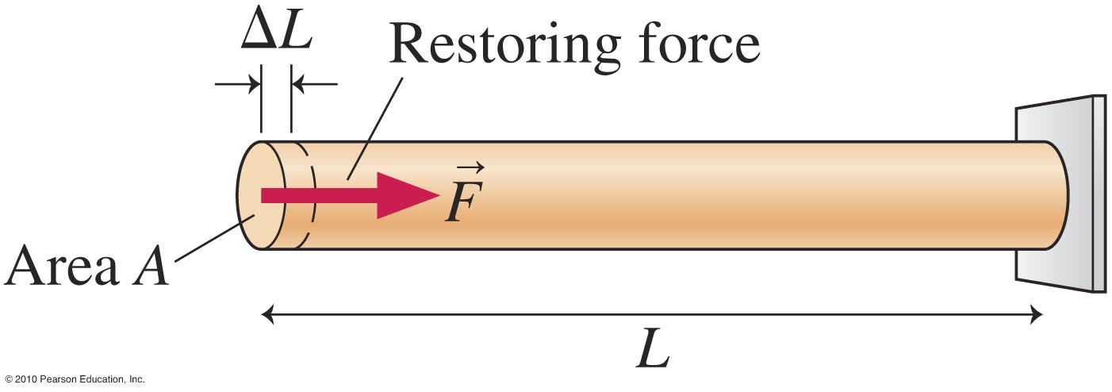
The Springiness of Materials: Young’s Modulus
The force exerted by a stretched or compressed rod has the same form as Hooke’s law:
YA
F = L
L
Y is Young’s modulus, which depends on the material that the rod is made of.
Slide 8-30

Slide 30
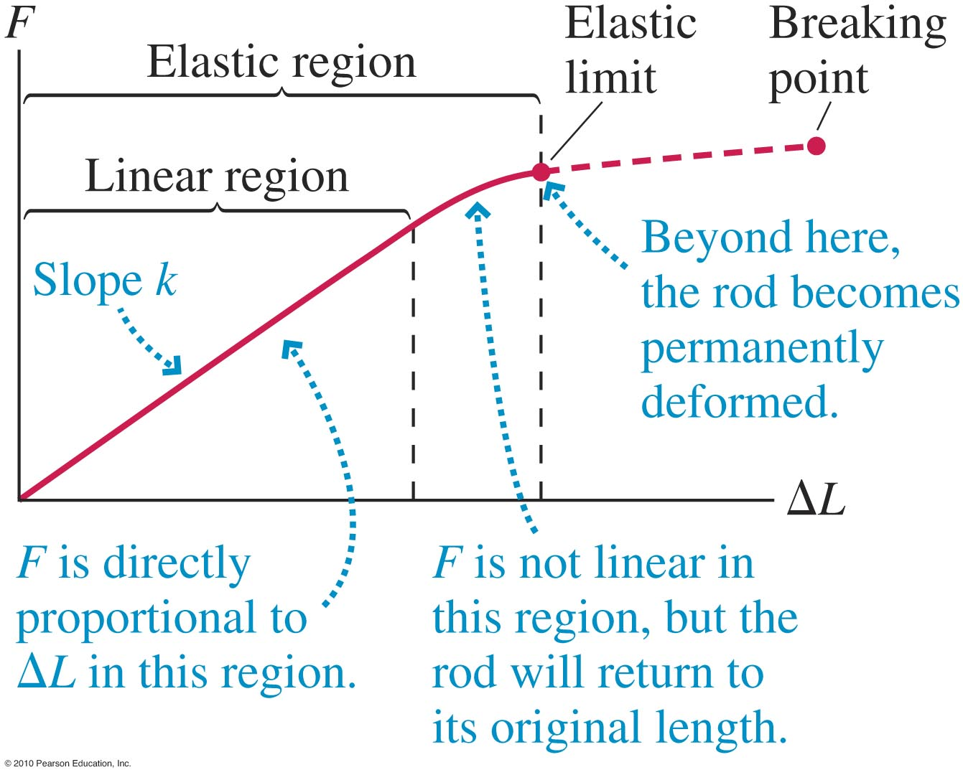
Beyond the Elastic Limit
Slide 8-31

Slide 31
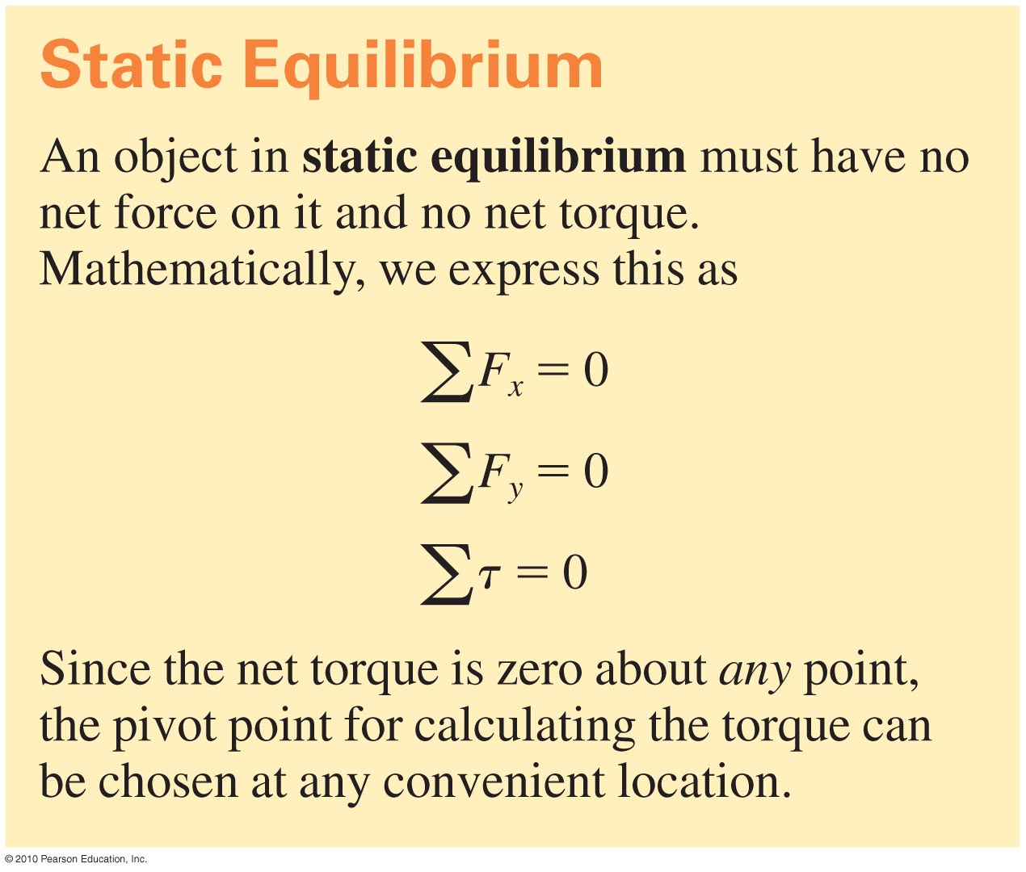
Summary
Slide 8-32

Slide 32
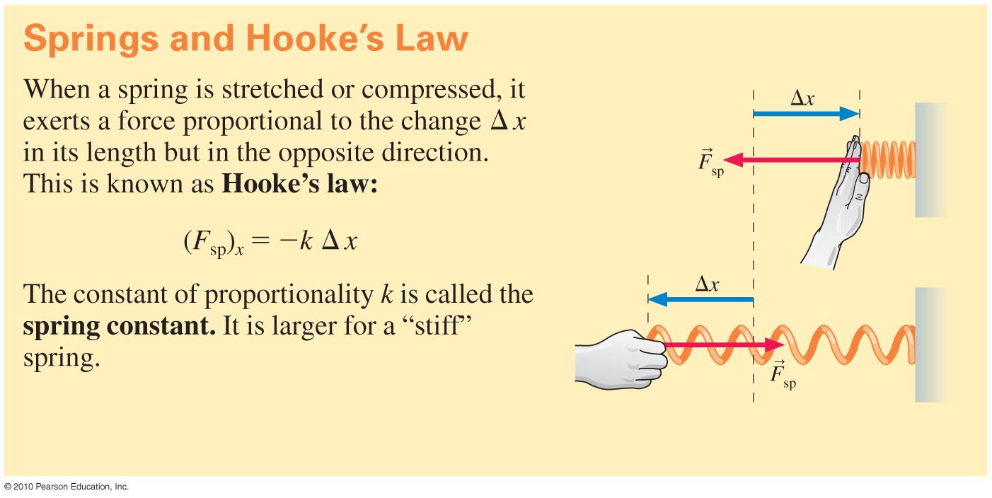
Summary
Slide 8-33

Slide 33
Additional Example Problem
A spring with spring constant k = 125 N/m is used to pull a 25 N wooden block horizontally across a tabletop. The coefficient of friction between the block and the table is µk = 0.20. By how much does this spring stretch from its equilibrium length?
Slide 8-34

